Slide 1

Flow mate – AI-Powered Menstrual & Emotional Wellness App
A Pitch Deck by Maureen Gathoni

Slide 2

🌸 Flowmate – Empowering Women Through Every Cycle
Flowmate blends AI, emotional intelligence, and women’s health into one empowering experience.
AI-powered menstrual and emotional wellness companion.
This presentation details our innovative solution for addressing the critical need for emotional support throughout the menstrual cycle.
By: Maureen Gathoni – Founder & Developer

Slide 3
💢 The Silent Struggles During Menstrual Cycles
The emotional burden of cyclical changes is often overlooked by existing health solutions. We see a significant gap in compassionate support.
Pervasive Emotional Shifts
The Support Gap
Tracking vs. Truly Helping
There is a critical lack of dedicated, real-time emotional support or personalized affirmations tailored to cyclical changes.
80% of women experience emotional fluctuations, ranging from stress and anxiety to fatigue, during their cycle.
Existing apps focus primarily on physical tracking, neglecting the vital component of emotional well-being.
“Women don’t just need reminders — they need understanding.”

Slide 4

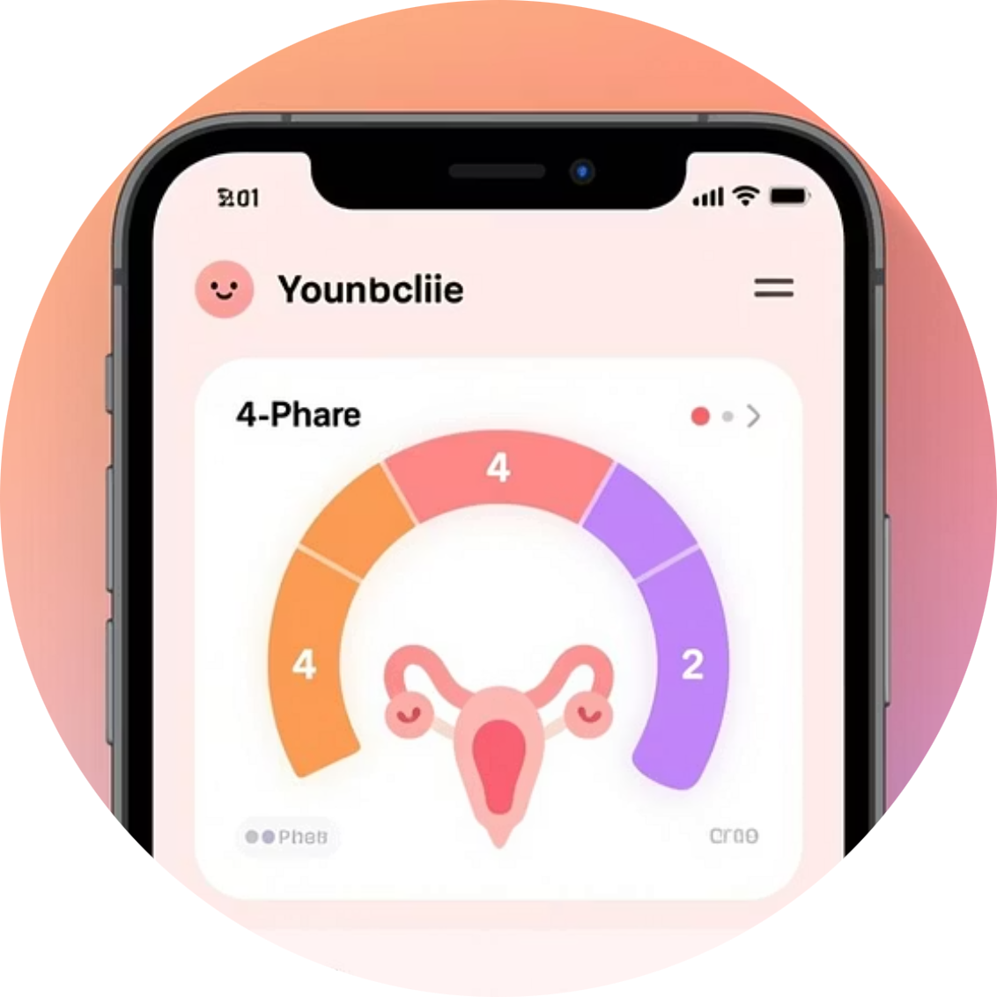

🌸 Introducing Flowmate: AI That Listens
Personalized Affirmations
Comprehensive Cycle Tracking
24/7 AI Chatbot Support
Delivers encouraging messages based on the user's current cycle phase and documented emotional state.
Accurately tracks all phases: menstrual, follicular, ovulation, and luteal, providing relevant wellness context.
Offers immediate, non-judgmental support and personalized check-ins whenever the user needs it most.
Flowmate is an AI-powered menstrual health companion designed to bridge the gap between physical health and emotional wellness.

Slide 5




⚙️ Technology That Cares: The Flowmate Loop
Our proprietary system uses deep learning models to translate subjective emotional data into actionable, personalized support.
User Input & Logging
Emotion Sensor & AI Check
Cycle data, mood logs, detailed stress levels, and emotional keywords are captured securely.
Advanced sentiment analysis detects tone from user messages, adjusting the AI's response strategy in real-time.
Adaptive Chatbot Response
Insights & Self-Care Plan
Provides affirmations, personalized coping prompts, self-care suggestions, and contextual advice.
Generates emotional health reports, identifying patterns and offering data-driven self-care suggestions.
Our core AI logic is built on Python using frameworks like TensorFlow for sophisticated mood detection and accurate model training.

Slide 6

📊 A Growing Wellness Market
The demand for digital solutions in women's health and wellness presents a massive opportunity for Flowmate to capture market share.
$60B+
500M+
15%
FemTech Market Value
Active Users
Focus on Mental Wellness
Number of women globally who actively use health-tracking applications.
Projected size of the Global FemTech market by 2027, indicating rapid growth and investment.
The small percentage of existing apps that prioritize emotional or mental wellness support, highlighting our niche.
Our primary target users are women aged 16–45, including students, professionals, and mothers who prioritize personalized wellness and self-care solutions.

Slide 7

💎 Why Flowmate Stands Out
Flowmate is uniquely positioned by integrating empathy-driven AI with crucial physical health tracking features.
AI with Empathy
Holistic Health Integration
Real-Time, Adaptive Interaction
Unlike generic trackers, Flowmate's AI responds to the emotional tone and sentiment of the user's input, not just the keywords.
The seamless integration of mental health check-ins and cycle tracking offers a truly comprehensive self-care tool.
Features a dedicated emotional sensor for adaptive support and real-time cycle insights and health analytics.
“Not just a tracker — a companion that listens.”

Slide 8





💰 Revenue Streams for Sustainable Growth
We have designed a diverse monetization strategy leveraging subscriptions, partnerships, and ethical data insights.
Freemium Subscription
Strategic Partnerships
Free core features, with premium access for advanced AI insights, customized self-care routines, and detailed emotional reports.
Collaborations with health & wellness brands, licensed counselors, and other FemTech organizations for co-marketing and service integration.
Curated In-App Store
Ethical Data Insights
Monetization through the sale of curated physical self-care kits, specialized digital content, and guided wellness programs.
Provision of anonymized emotional wellness analytics to research institutions and public health initiatives (fully opt-in and privacy compliant).

Slide 9


📈 Our Early Momentum & Validation
Flowmate has already demonstrated significant emotional impact and high technical accuracy in initial trials.
Prototype Success
"This is the first time an app has truly acknowledged the emotional chaos of my period. It felt like talking to a friend." - Beta Tester, 28
Tested with a cohort of 50 health-conscious women.
95% of testers reported "feeling emotionally supported" during critical cycle phases.
AI chatbot accuracy achieved 85% correct sentiment detection in test scenarios.
"The daily affirmations were incredibly relevant to how I was feeling on that specific cycle day." - Beta Tester, 34
Impact Recognition
Flowmate's mission aligns with global development goals:
Recognized under SDG 3: Good Health and Well-being.
Recognized under SDG 5: Gender Equality.

Slide 10
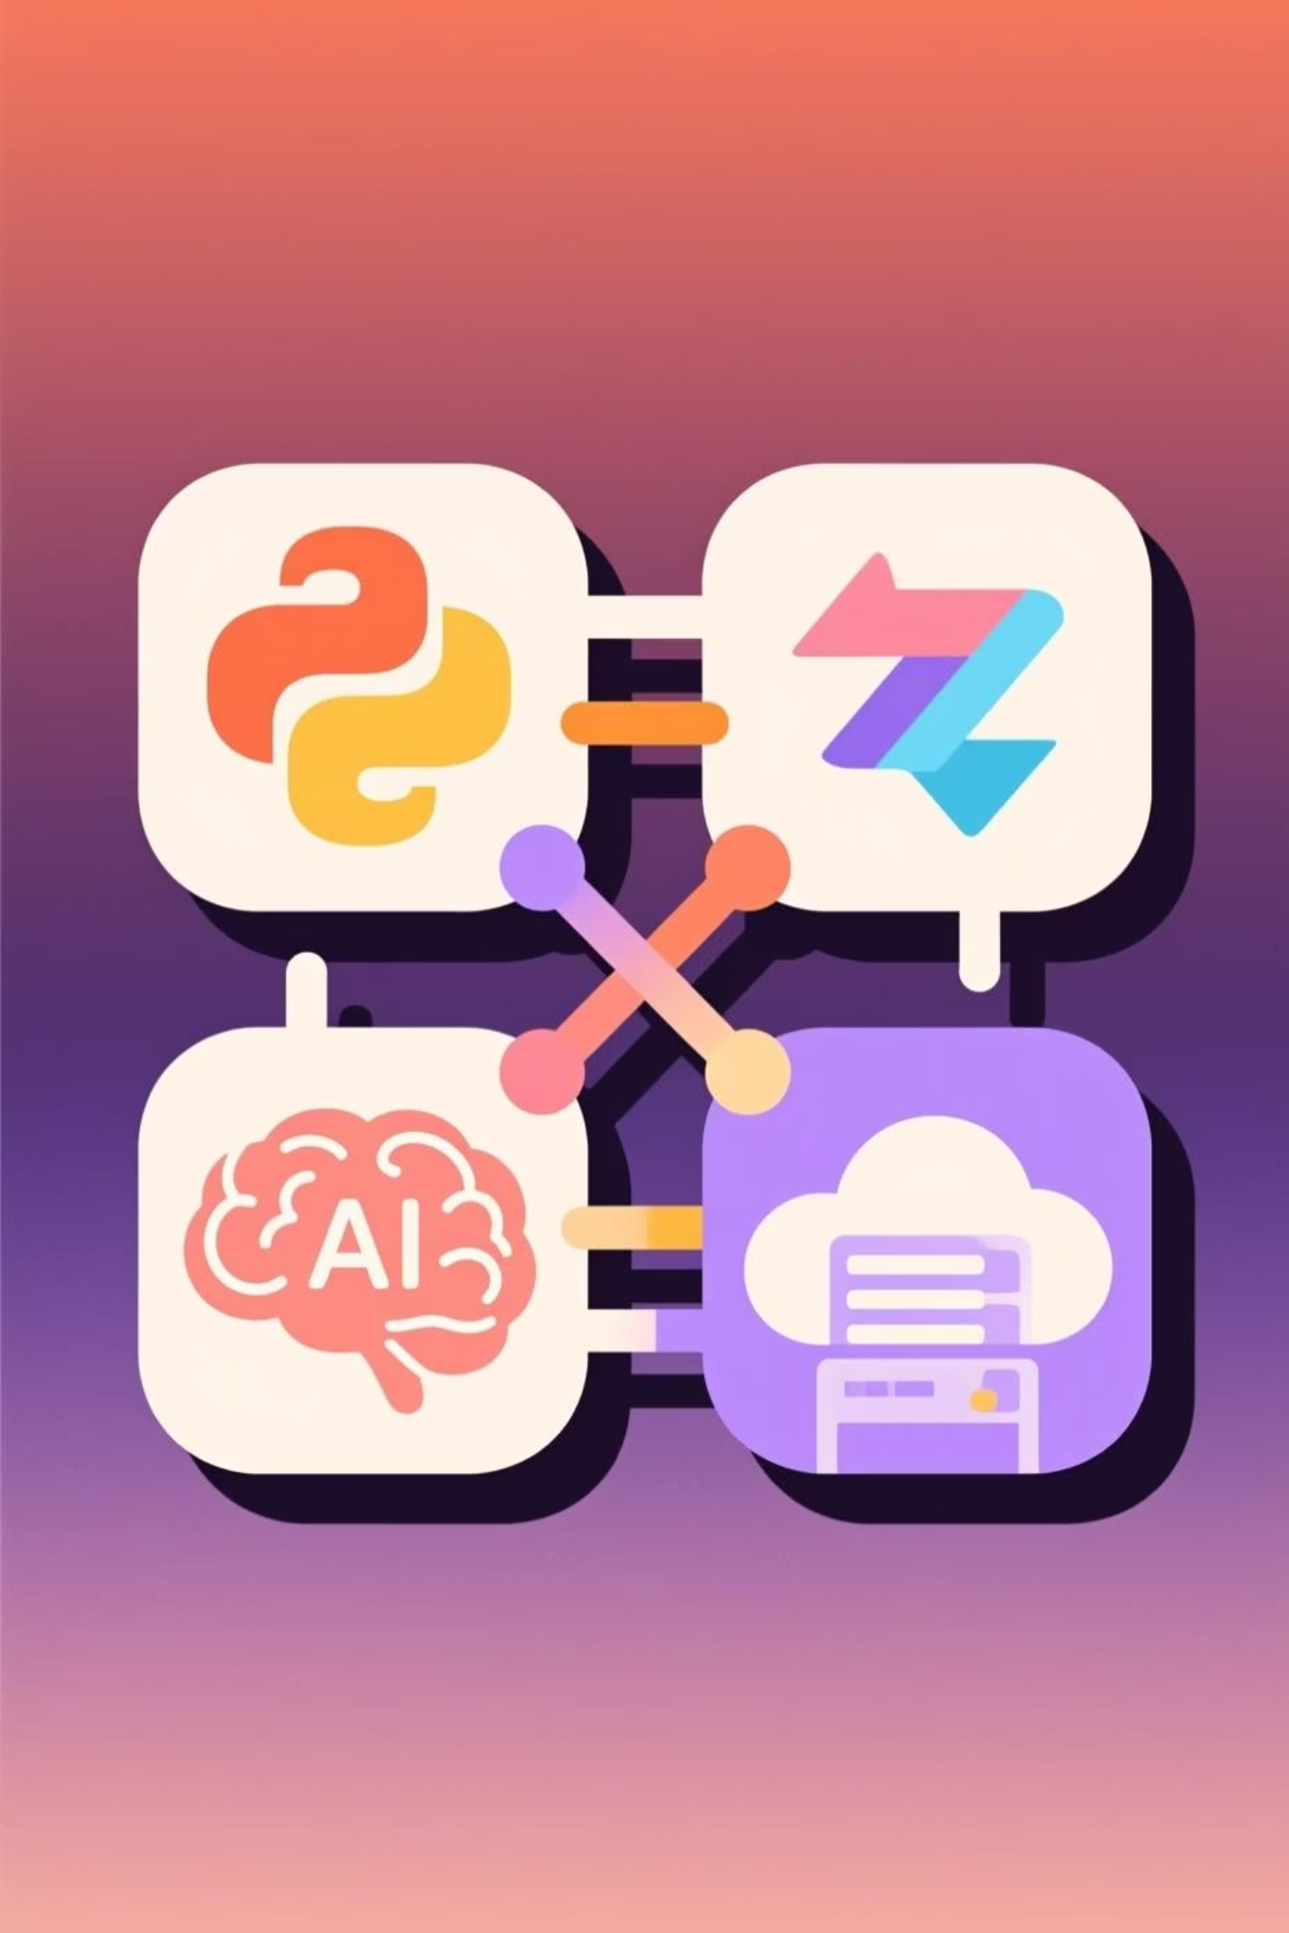
🤖 Under the Hood: Our Core Technology
A robust and scalable technology stack ensures Flowmate provides reliable, real-time emotional and cycle support.
Frontend
Html 5 / Streamlit: Provides a beautiful, cross-platform, and responsive user experience.
Backend & Logic
Python + Flask: A lightweight yet powerful framework for managing application logic and API endpoints.
AI Modeling
Sentiment Analysis (HuggingFace Transformers): State-of-the-art models for real-time emotional sensing and sentiment accuracy.
Database & Data Flow
Firebase / MongoDB: Secure, scalable databases for user data, cycle logs, and real-time sentiment input.

